Slide 1
Unit -1 Operating System Overview
Unit 1-
Operating System Overview: Operating system objectives and functions, evolution of operating system, basic concepts: Processes, Files, System Calls, Layered structure v/s Monolithic structure of OS

Slide 2
Operating System
A program that controls the execution of application programs
A program that controls the execution of users programs
An interface between applications and hardware

Slide 3
1. Operating System Objectives
Convenience
Makes the computer more convenient to use
Efficiency
Allows computer system resources to be used in an efficient manner
Ability to evolve
Permit effective development, testing, and introduction of new system functions without interfering with service

Slide 4
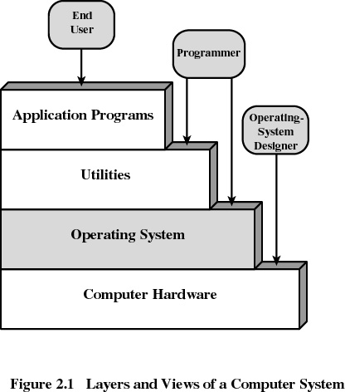
2. Layers of Computer System

Slide 5
Kernel
Heart (vital portion) of the operating system
Next to Hardware
It always resides in main memory
Contains most-frequently used functions
Also called the nucleus

Slide 6
3. Services Provided by the Operating System
Program development
Editors, compilers, linker, loader and debuggers
Program execution
Access to I/O devices
Controlled access to files
Access to other plug and play devices
Security to users programs and applications

Slide 7
Services Provided by the Operating System
Error detection and response
internal and external hardware errors
memory error
device failure
software errors
arithmetic overflow
access forbidden memory locations

Slide 8
Services Provided by the Operating System
Accounting
collect statistics
monitor performance

Slide 9
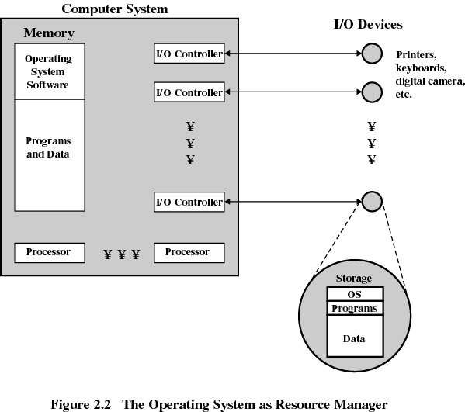

Slide 10
4. Evolution of Operating Systems
4.1 Serial Processing
No operating system
Machines run from a console with display lights and toggle switches, input device, and printer
Setup included loading the compiler, source program, saving compiled program, and loading and linking

Slide 11
Evolution of Operating Systems
4.2 Simple Batch Systems
Monitors
Software that controls the running programs
Batch jobs together
Program branches back to monitor when finished
Resident monitor is in main memory and available for execution

Slide 12
Job Control Language (JCL)
Special type of programming language
Provides instruction to the monitor
what compiler to use
what data to use

Slide 13
Hardware Features
Memory protection
do not allow the memory area containing the monitor to be altered
Timer
prevents a job from monopolizing the system

Slide 14

4.3 Uniprogramming
Processor must wait for I/O instruction to complete before preceding

Slide 15
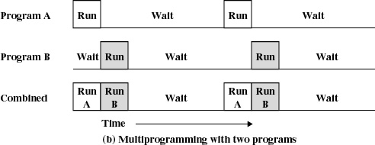
4.4 Multiprogramming
When one job needs to wait for I/O, the processor can switch to the other job

Slide 16
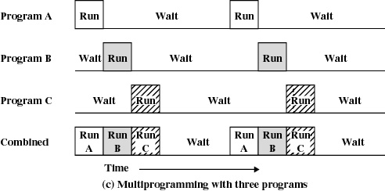
Multiprogramming

Slide 17
Example
JOB1 JOB2 JOB3
Type of job Heavy compute Heavy I/O Heavy I/O
Duration 5 min. 15 min. 10 min.
Memory required 50K 100 K 80 K
Need disk? No No Yes
Need terminal No Yes No
Need printer? No No Yes

Slide 18
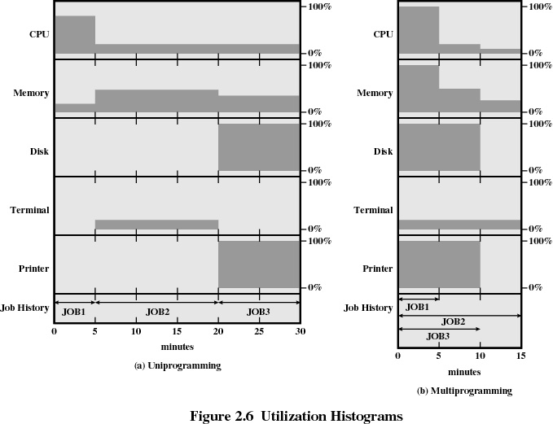

Slide 19
Effects of Multiprogramming
Uniprogramming Multiprogramming
Processor use 22% 43%
Memory use 30% 67%
Disk use 33% 67%
Printer use 33% 67%
Elapsed time 30 min. 15 min.
Throughput rate 6 jobs/hr 12 jobs/hr

Slide 20
4.5 Time Sharing
Using multiprogramming to handle multiple interactive jobs
Processor’s time is shared among multiple users
Multiple users simultaneously access the system through terminals

Slide 21
Batch Multiprogramming versus Time Sharing
 | Batch Multiprogramming | Time Sharing
Principal objective | Maximize processor use | Minimize response time
Source of directives to operating system | Job control language commands provided with the job | Commands entered at the terminal

Slide 22
Major Achievements
Running processes simultaneously
Memory Management
Information protection and security
Scheduling and resource management

Slide 23
5. Processes
A program in execution
An instance of a program running on a computer
The entity that can be assigned to and executed on a processor
A unit of activity characterized by a single sequential thread of execution, a current state, and an associated set of system resources

Slide 24
Process
Consists of three components
An executable program
Associated data needed by the program
Execution context of the program
All information the operating system needs to manage the process

Slide 25
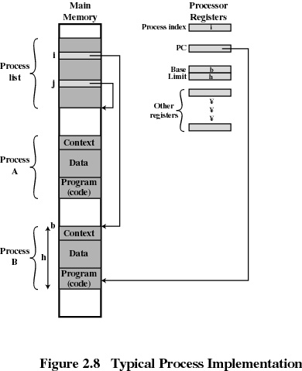
Process

Slide 26
6. Memory Management
Process isolation
Automatic allocation and management
Support for modular programming
Protection and access control
Long-term storage

Slide 27
Virtual Memory
Allows programmers to address memory from a logical point of view
While one process is written out to secondary store and the successor process read in there in no interruption

Slide 28
File System
Implements long-term store
Information stored in named objects called files

Slide 29
Information Protection and Security
Access control
regulate user access to the system
Information flow control
regulate flow of data within the system and its delivery to users
Certification
proving that access and flow control perform according to specifications

Slide 30
7. Scheduling and Resource Management
Fairness
give equal and fair access to all processes
Differential responsiveness
discriminate between different classes of jobs
Efficiency
maximize throughput, minimize response time, and accommodate as many uses as possible

Slide 31
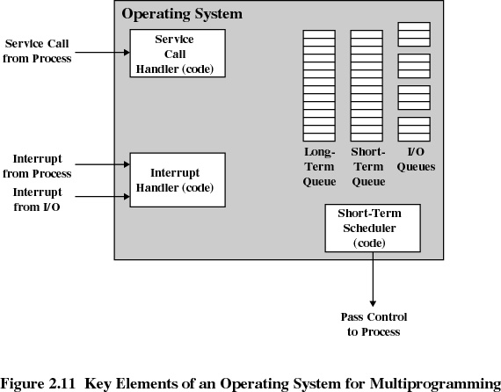
Major Elements of Operating System

Slide 32
System Structure
View the system as a series of levels
Each level performs a related subset of functions
Each level relies on the next lower level to perform more primitive functions
This decomposes a problem into a number of more manageable subproblems

Slide 33
5. Characteristics of Modern Operating Systems
Microkernel architecture
assigns only a few essential functions to the kernel
address space
Inter-process communication (IPC)
basic scheduling

Slide 34
Characteristics of Modern Operating Systems
Multithreading
Process is divided into threads that can run simultaneously
Thread
Dispatch-able unit of work
Executes sequentially and is interruptible
Process is a collection of one or more threads

Slide 35
Characteristics of Modern Operating Systems
Symmetric multiprocessing
There are multiple processors
These processors share same main memory and I/O facilities
All processors can perform the same functions

Slide 36
Characteristics of Modern Operating Systems
Distributed operating systems
Provides the illusion of a single main memory and single secondary memory space
Used for distributed file system

Slide 37
Characteristics of Modern Operating Systems
Object-oriented design
Used for adding modular extensions to a small kernel
Enables programmers to customize an operating system without disrupting system integrity

Slide 38
8. Operating System Design Hierarchy
Level name Objects Example Operations
13. Shell User programming Statements in shell language environment
. User processes User processes Quit, kill, suspend, resume
11 . Directories Directories Create, destroy, attach, search, list
10. Devices External devices, such Open, close,
as printer, displays read, write
and keyboards
9. File system Files Create, destroy, open, close, read, write
8.Communications Pipes Create, destroy, open. close, read, write

Slide 39
Operating System Design Hierarchy
Level name Objects Example Operations
7.Virtual Memory Segments, pages Read, write, fetch
6. Local secondary Blocks of data, device Read, write, allocate, free store channels
5. Primitive processes primitive process, Suspend, resume, wait, signal,semaphores, ready list

Slide 40
Operating System Design Hierarchy
Level name Objects Example Operations
4 Interrupts Interrupt-handling Invoke, mask, unmask, Programs retry
Procedures Procedure, call stack, Mark stack, call, return
Instruction Set Evaluation stack, micro- Load, store, add, subtract program interpreter,
branch scalar and array data
Electronic Registers, gates, buses, Clear, transfer,
circuit activate, etc.

